Slide 1
Breast Cancer Classification
An Exploration of Classification Models for Breast Cancer Diagnosis
Project guide: Team Member:
Suvarna Ranade Ma’am AnujChandak
Muskan Jain

Slide 2
Breif overview of Breast Cancer:
Cancer death is one of humanity's major problems in the developing world. Despite the fact that there are many ways to prevent it before happening, some cancer types still do not have a treatment. Breast cancer is one of the most common types of cancer, and early detection is crucial in its treatment. It develops from breast tissue when cells in the region grow out of control. One of the key steps in treating breast cancer is accurate diagnosis.
Significance of Early Detection:
Early detection is a cornerstone in the fight against breast cancer, offering numerous benefits to individuals, healthcare systems, and society as a whole. It underscores the importance of regular screenings, breast self-exams, and awareness campaigns to empower individuals in the timely detection of breast cancer.
Objective:
The objectives of a breast cancer classification project typically revolve around leveraging machine learning and data analysis techniques to develop a model capable of accurately classifying breast cancer cases

Slide 3
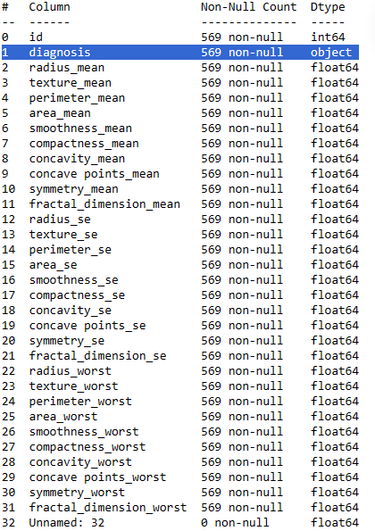
Dataset Overview: mmmssss
We can exclude unnecessary columns from the dataset and separate dependent (y) and and independent(X) data:
There is an id that cannot be used for classification.
Diagnosis is our class label.
Unnamed: 32 feature includes NaN so we do not need it.

Slide 4
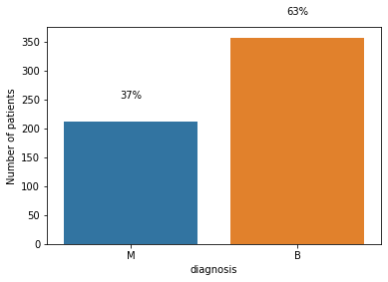
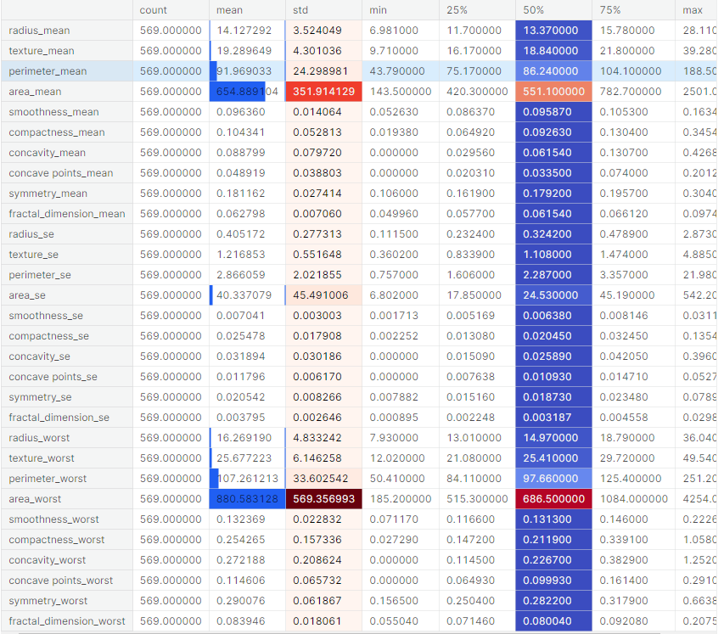
Analysis of input variable:
Analysis of output variable(diagnosis):
There is high variation in values in area_mean and area_worst.
There are many variables have median value 0.
The area_worst feature’s max value is 4254 and fractal_dimension_se features’ max 0.029840. This indicates we need to standardize or normalize data before visualization, feature selection, and classification.
Bar plot of diagnosis shows that Malignant and Benign patients ratio is 37% (212/569) and 63% (357/569) respectively.

Slide 5
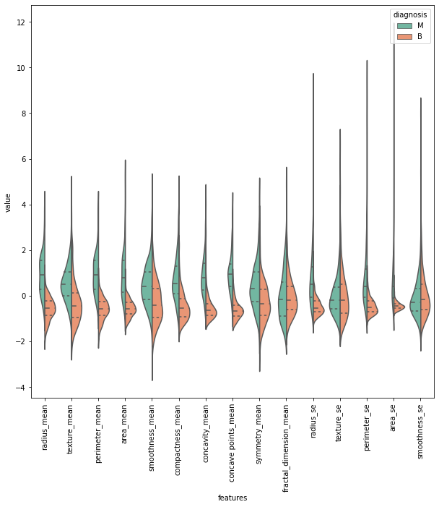
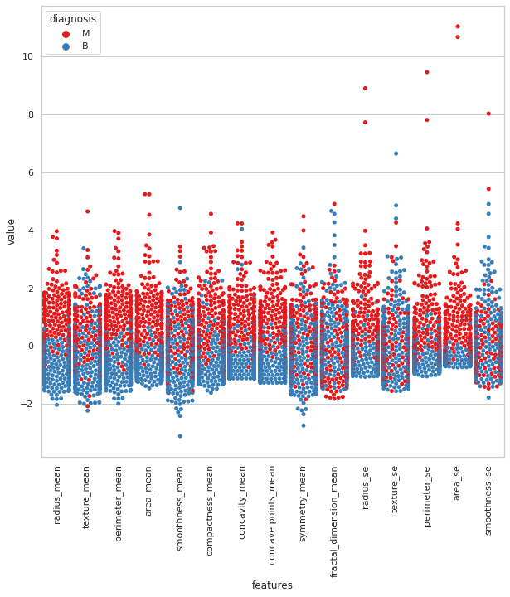
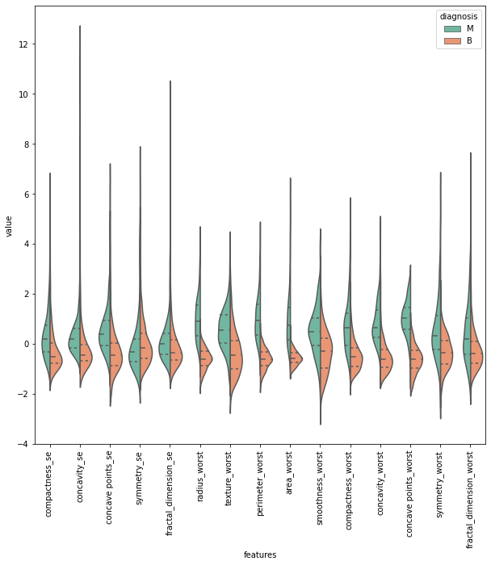
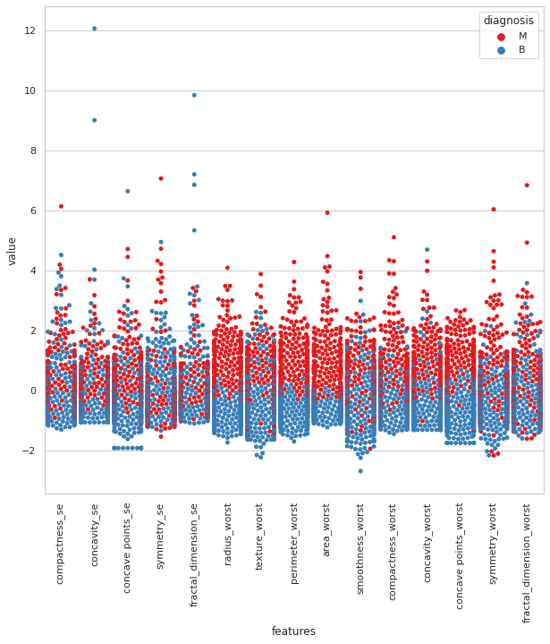
Violen plot:
Swarm plot:
In radius_mean,texture_mean,perimeter_mean, area_mean, compactness_mean, concavity_mean and concave_points_mean features, median of the Malignant and Benign looks like separated so it can be good for classification. However, in fractal_dimension_mean, texture_se, and smoothness_se features, median of the Malignant and Benign does not looks like separated so it does not gives good information for classification.
Radius_mean, area_se in the above swarm plot looks like malignant and benign are separated not totally but mostly. However, smoothness_mean,symmetry_mean, fractal_dimension_mean, and texture_mean in the above swarm plot looks like malignant and benign are mixed so it is hard to classify while using these feature.
Variable of texture_se, smoothness_se, concavity_worst, and concave point_worst looks like similar but how can we decide whether they are correlated with each other or not.
radius_worst, area_worst in the above swarm plot looks like malignant and benign are separated not totally but mostly. However, compactness_se,symmetry_se, and smoothness_worst in the above swarm plot looks like malignant and benign are mixed so it is hard to classify while using these feature.

Slide 6
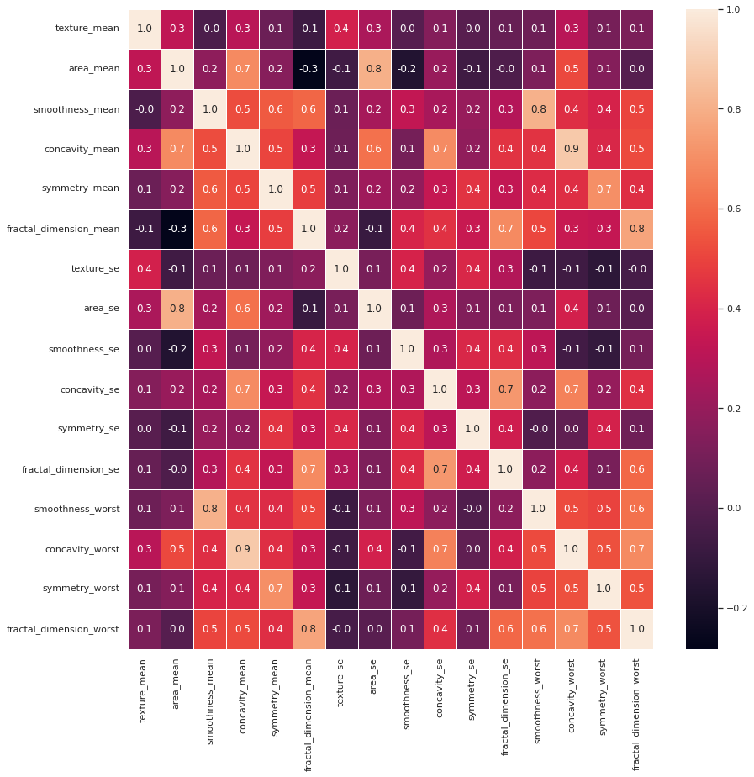
We applied Shapiro–Wilk test to all the numerical features to check whether they follow a normal distribution or not.
Heatmap
After drop correlated feature, there is only one high correlation value 0.9 between concavity_mean and concavity_worst.

Slide 7
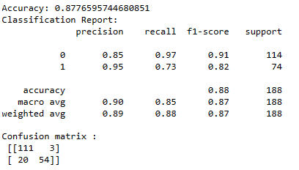
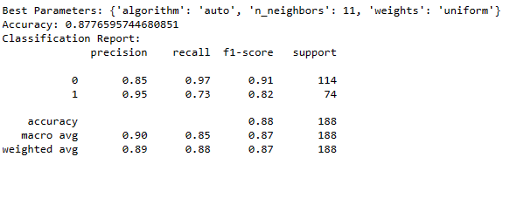
Model Selection
KNN ALGORITHM:
KNN algorithm is used in classification to predict the class of an input by identifying the majority class among its k-nearest neighbors in the feature space. It is a non-parametric and instance-based method where the decision is based on the most frequent class within the local neighborhood of the data point.
KNN ALGORITHM WITH HYPERPARAMETER:
It emphasizes on the inclusion of the hyperparameter ‘k’ and the process of selecting the best ‘k’ value to achieve best model.

Slide 8
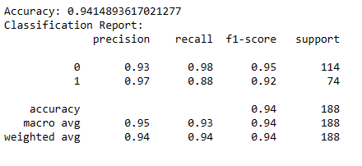
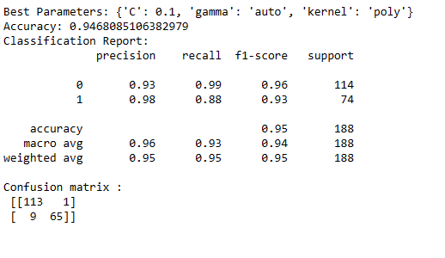
Support Vector Machine (SVM) is a supervised machine learning algorithm used for classification tasks.
It works by finding the optimal hyperplane that separates different classes in the feature space.
SVM aims to maximize the margin between classes, making it robust and effective, especially in high-dimensional spaces.
Support Vector Machine (SVM) hyperparameters include 'C' for regularization strength, controlling the trade-off between smooth decision boundaries and correct classification. Another key hyperparameter is the 'kernel' choice (linear, polynomial, radial basis function, etc.) influencing decision boundary flexibility. 'Gamma,' associated with some kernels, regulates the influence of a single training example, impacting the shape of the decision boundary.
SVM classification:
Hyperparamenter SVM:

Slide 9
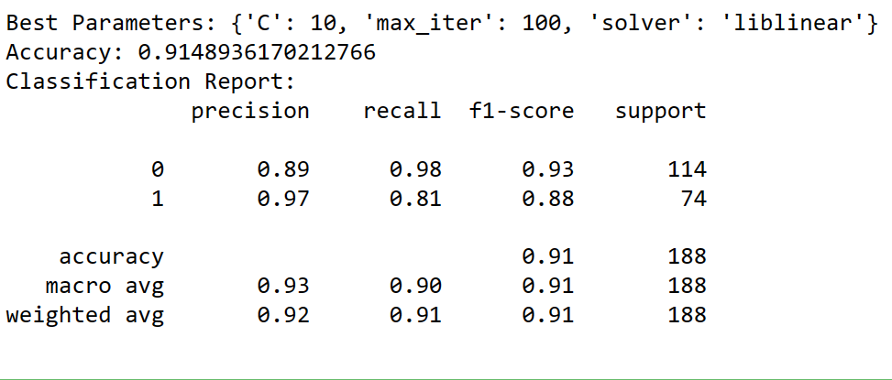
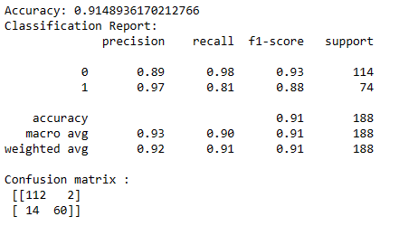
Logistic Regression
Logistic regression is a statistical model for binary classification, predicting the probability of an instance belonging to a particular class. It employs the logistic function to map a linear combination of input features into a range of probabilities between 0 and 1. Parameters are optimized through maximum likelihood estimation, and a threshold is applied to make the final classification decision.
Hyperparameter Logistic Regression:
In logistic regression, the 'C' hyperparameter controls regularization strength, balancing the trade-off between fitting the training data and preventing overfitting. A lower 'C' value increases regularization, and a higher value reduces it, influencing the model's complexity.

Slide 10
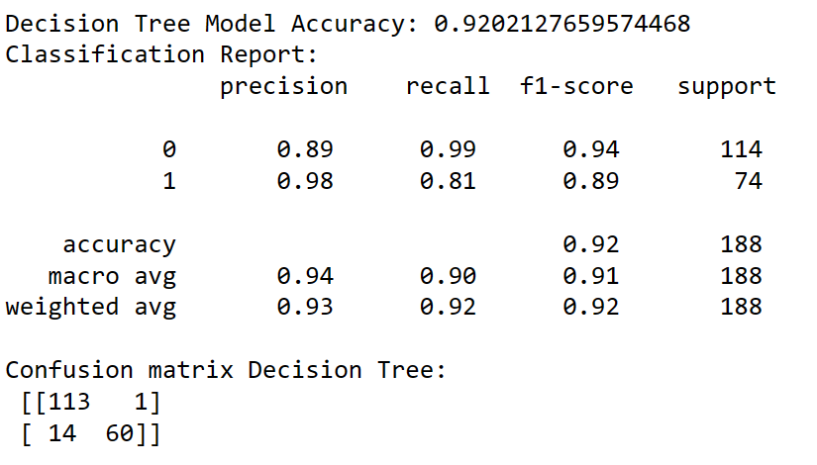
Decision Tree Classifier:
A decision tree classifier is a machine learning algorithm that recursively splits the data based on feature conditions to create a tree-like structure, enabling decision-making by traversing from the root to a leaf node for classification.
Hyperparameters, like tree depth and minimum samples per leaf, impact model complexity and generalization.
Best Parameters: {'criterion': 'entropy', 'max_depth': 4,
'min_samples_leaf': 1, 'min_samples_split': 5}

Slide 11
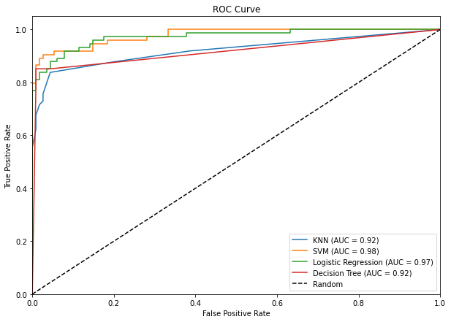
​
ROC CURVE:
The SVM model outperformed KNN, Logistic Regression
and Decision Tree models with the highest AUC-ROC score of 0.98,
showcasing its superior predictive ability for the dataset.
Therefore, the SVM model is recommended for accurate classification in this context.
In [ ]:

Slide 12
Thankyou

